Slide 1


Introduction to Apache Storm
Group Activity:
Apache Storm
Subject:
INTERNET OF THINGS (IOT) (21CST702)
Group Members :
Hajaratali s Mogalalli(1DA22CS409)
Arun G Koravanavar(1DA21CS027)
Arya N D(1DA21CS028)
Bharatkumar N Medegar(1DA21CS033)
Arjun Pundir(1DA21CS026)
Ayushman Sharan(1DA21CS029)
Abhay Singh(1DA21CS004)
Akhil Kumar Tiwari(1DA21CS014)
Under the guidance of ;
prof . Lavanya Santhosh
Assistant Professor
Dr.AIT
Introduction to Apache Storm

Slide 2
Index
Apache Storm – Home Apache Storm
Introduction Apache Storm
Core Concepts Apache Storm – Cluster Architecture
Apache Storm – Workflow
Storm - Distributed Msging System
Apache Storm - Working Example
Apache Storm – Trident
Apache Storm in Twitter
Introduction to Apache Storm

Slide 3

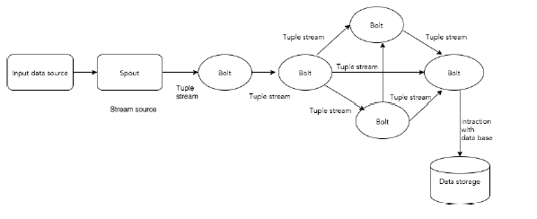
Apache Storm - Core Concepts
Apache Storm reads raw stream of real-time data from one end and passes it through a sequence of small processing units and output the processed / useful information at the other end.
Tuple
Let us now have a closer look at the components of Apache Storm.

Slide 4

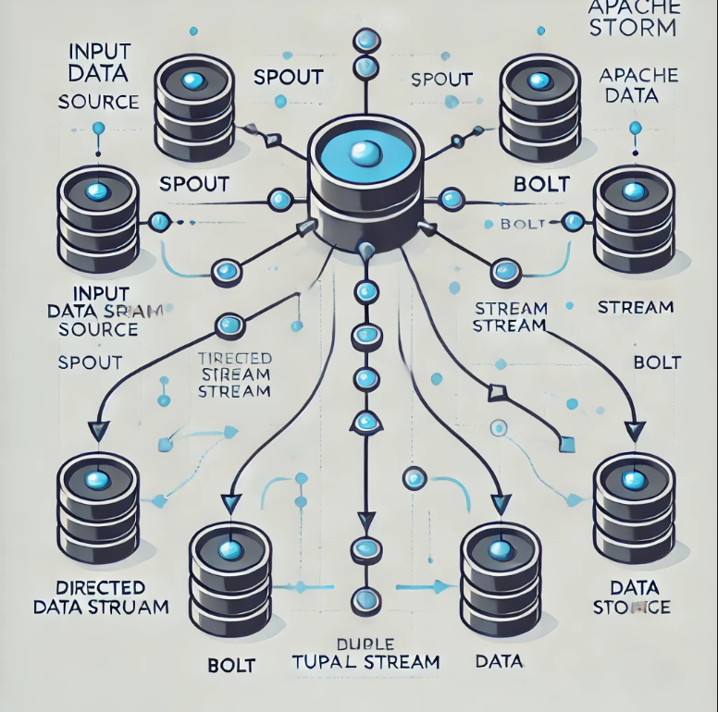
Apache Storm - Core Concepts
The following diagram depicts the core concept of Apache Storm.
Introduction to Apache Storm

Slide 5
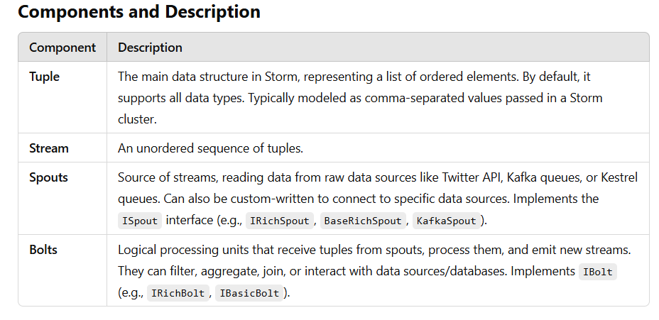
Apache Storm - Core Concepts
The following diagram depicts the core concept of Apache Storm.
Introduction to Apache Storm

Slide 6
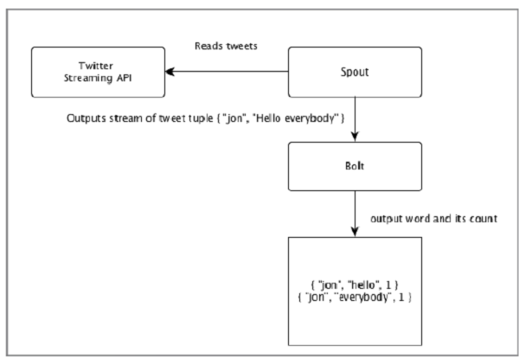
Apache Storm - Core Concepts
The following diagram depicts the core concept of Apache Storm.
Example: Twitter Analysis
Input: Tweets are fetched from the Twitter Streaming API by a spout, which emits them as tuples, e.g., ["username", "tweet"].
Processing:
Bolt 1 splits the tweet into words.
Bolt 2 calculates the word count.
Data is persisted to a configured database.
Output:
Results can be queried from the database.
Introduction to Apache Storm

Slide 7

Apache Storm - Core Concepts
Topology
Spouts and bolts are connected to form a topology, which represents real-time application logic.
Topology
A directed graph, where:
Vertices: Computation units (spouts and bolts).
Edges: Stream of data.
Starts with spouts that emit data to bolts.
Storm keeps the topology running continuously until manually terminated.
Tasks
Execution of spouts and bolts is referred to as a task.
Tasks run in parallel, with multiple instances of spouts and bolts executing in separate threads.
Workers
Topologies run on multiple worker nodes in a distributed manner.
Worker nodes listen for jobs and manage their execution.

Slide 8

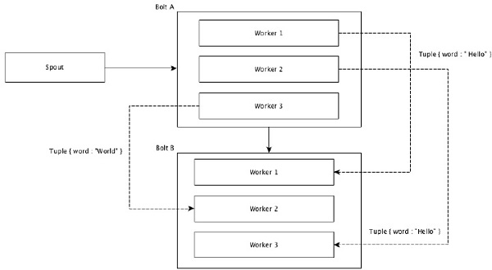
Apache Storm - Core Concepts
Stream of data flows from spouts to bolts or from one bolt to another bolt. Stream grouping controls how the tuples are routed in the topology and helps us to understand the tuples flow in the topology. There are four in-built groupings as explained below.
Shuffle Grouping
In shuffle grouping, an equal number of tuples is distributed randomly across all of the workers executing the bolts. The following diagram depicts the structure.

Slide 9

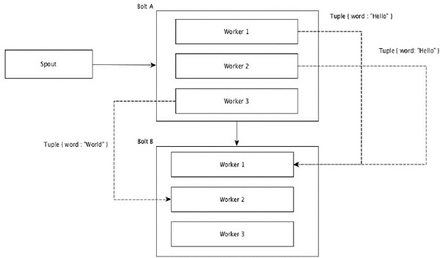
Apache Storm - Core Concepts
Field Grouping
The fields with same values in tuples are grouped together and the remaining tuples kept outside.
Then, the tuples with the same field values are sent forward to the same worker executing the bolts.
For example, if the stream is grouped by the field “word”, then the tuples with the same string, “Hello” will move to the same worker. The following diagram shows how Field Grouping works.

Slide 10
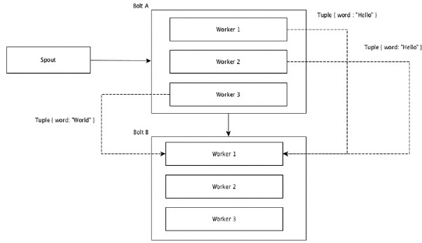
Apache Storm - Core Concepts
Global Grouping
All the streams can be grouped and forward to one bolt. This grouping sends tuples generated by all instances of the source to a single target instance (specifically, pick the worker with lowest ID).

Slide 11
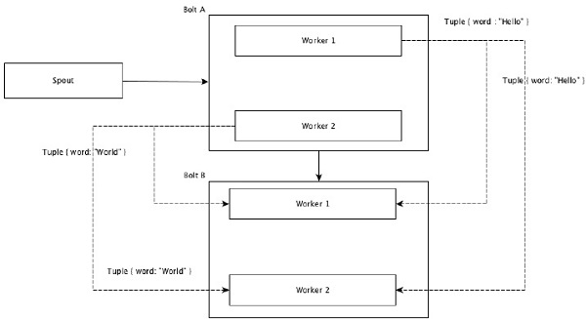
Apache Storm - Core Concepts
All Grouping
All Grouping sends a single copy of each tuple to all instances of the receiving bolt. This kind of grouping is used to send signals to bolts. All grouping is useful for join operations.

